Slide 1
Plane Wave Propagation: Dielectric Medium
How a dielectric medium affects the propagation of an electromagnetic plane wave.
To determine the relative dielectric constant of an unknown material by using the a parallel wave experiment
Determine the propagation constant, phase constant, and attenuation constant of a dielectric material.
Calculate the phase velocity of an electromagnetic wave in a dielectric medium.
Calculate the skin depth of a dielectric material.

Slide 2
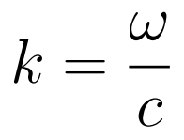
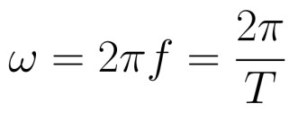
Plane Wave Propagation: Travelling Waves
We have studied the Maxwell’s Equations, used them to derive the wave equation, and proven that a time-harmonic plane wave is a solution to the wave equation (and therefore obeys Maxwell’s equations) as long as the following relationship is true:
In this case, the general form of the solution is known as a “traveling wave,” which takes the following form:
Recall that the negative sign corresponds to a wave moving toward positive z (to the right), while the positive sign signifies a wave moving toward negative z (to the left).
Eqn (1) can be very difficult to visualize, because it is evolving in both time and space at the same time. Also, there are three different variables that represent time variation and two different variables that represent spatial variation. The variables for time variation are related as follows:
To isolate the effect of these variables, we must watch the evolution of the signal at a particular point in space, such as z=0. In that case, the traveling wave equation reduces to a simple time- dependent sinusoid:
This function can be easily visualized, as shown in Fig. 1. Remember that this figure shows the field at a particular point in space as the wave flows past it. We will sit on that point forever, watching as the wave moves past. Notice that we must specify the point in space where we are watching, as well as one of the three constants (ω, f, or T) that specify how quickly the wave changes in time.
(1)
(2)
(3)
(4)

Slide 3
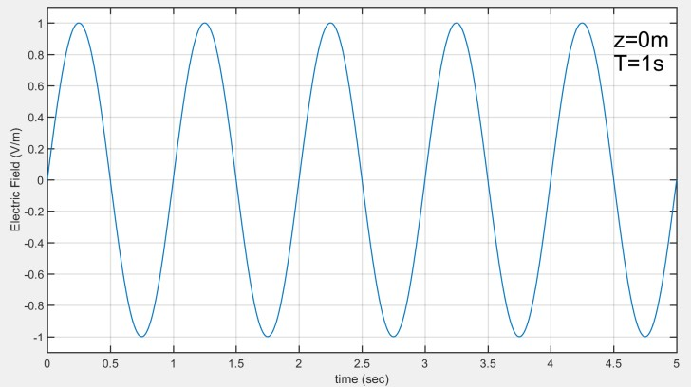
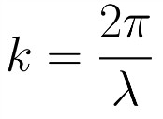
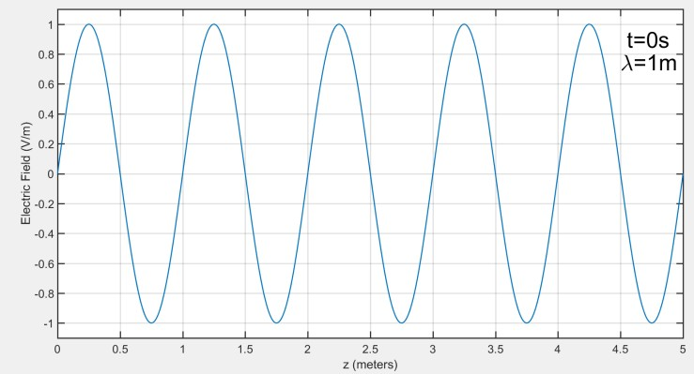
Fig. 1. Time Evolution of a Traveling Wave Moving Past a Point in Space
Conversely, if we focus on the spatial evolution of a wave, the variables that control spatial variation are related as follows:
To observe the spatial variation, we must select a single moment in time, such as t=0. In this case, the traveling wave equation reduces down to Equation 20.5:
This function can be easily visualized as shown in Fig. 2. Remember that this figure illustrates a snapshot of the electric field at all locations in space for a single point in time. Notice that we must specify the point in time where we are taking the snapshot, as well as one of the two constants (λ or k) that specify how quickly the wave changes in space.
(5)
(6)
Fig. 2 Snapshot of Spatial Variation of a Traveling Wave at a Particular Moment in Time
If Figs. 1 & 2 look very similar to each other, they are. That’s part of why traveling waves are confusing, and why you must think about them very precisely. Just as we can think of a signal in the time domain or in the frequency domain, we can also think of traveling waves.

Slide 4
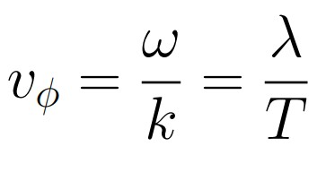
from a time perspective or from a spatial perspective. It is very easy to confuse these two, but keeping them separate helps to understand the waves.
In particular, if you are comfortable with radial frequency ω from the time perspective, then the wave number k fills exactly the same role in the spatial perspective. Neither can be quickly and easily identified from a figure, but both appear quite clearly in the traveling wave equation. Similarly, period T and wavelength λ are analogous to each other, and both can be easily identified in the corresponding figures.
The wave varies in time, and it varies in space, but a fixed relationship between those rates of change must be maintained in order to ensure that the wave propagates at the correct velocity. The earlier equation can actually be expanded as follows, showing two different (and equivalent) relationships between time and spatial variations, both of which help to set the velocity of wave propagation.
Recall that in free space, vφ=c, but this will not be the case in dielectric materials.
Example 1: If a wave is traveling in free space with a wavelength of 2m, determine the radial frequency, wave number, and period.
(7)
Wave Number and Phase Velocity in Dielectric Materials
When an electromagnetic wave is propagating in a dielectric medium (such as glass or plastic) rather than in free space, the wave number changes. This means that the rate at which the wave varies in space will change. Recall that we can calculate the wave number in free space as follows:

Slide 5
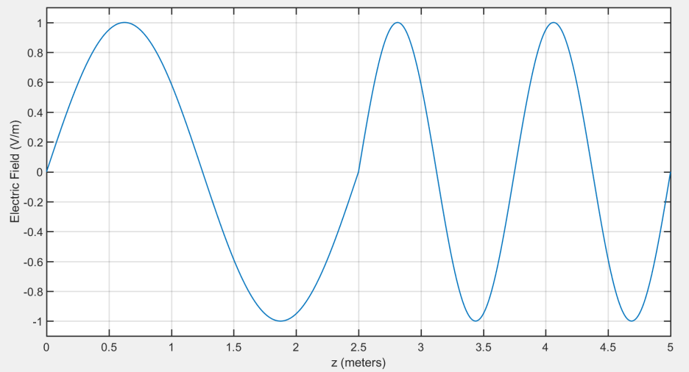
This equation will be modified to include the relative permittivity and relative permeability when the wave is traveling through any material other than a vacuum:
Typically, μr will be equal to one unless the wave is traveling through a ferromagnetic material, but εr can have a very substantial impact on the wave number and, therefore, the rate of spatial variation of the wave.
The most interesting thing about this situation is that the rate of time variation does not change. The radial frequency ω will be constant no matter what material the wave passes through. This is a very important principle to remember: The wave number changes depending on the material, but the radial frequency is always the same. This effect is illustrated in Fig. , which shows a change in the wave number as an electromagnetic wave moves from vacuum into glass, which changes the wavelength from 2.5 m to 1.25 m:
Air (λ=2.5m)
Glass (λ=1.25m)
Fig. 3. Wavelength and Wave Number Change at a Material Transition
Example 2: What is the relative dielectric constant εr for the glass in Fig. 3?
Although it appears that the wave is changing more quickly in the glass in Fig. 3, it is actually moving more slowly. Think about it this way: In the air, the wave moves 2.5 m over one time cycle, but in the glass, it only moves 1.25 m over that same time cycle. It is also very

Slide 6
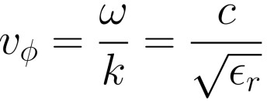
important to remember that the speed of light can never exceed the value for free space, which is approximately 3x10⁸ m/s. When light enters in a material other than the free space, the wave number always increases, and the velocity always decreases according to the following equation:
Example 3: What is the phase velocity of the electromagnetic wave in both regions of Fig. 3?
The Parallel Wave Experiment
We can take advantage of the change in wave number to determine the dielectric constant of an unknown material. Consider an experiment in which an electromagnetic wave (such as light) is first split into two beams, and then the two beams are passed through equal lengths of two different materials. Typically, the relative dielectric constant of one of the materials is known, and the relative dielectric constant of the other material is unknown. Frequently, the “known” material would be free space, and the “unknown” material would be a dielectric such as glass or plastic.
Since the relative dielectric constant is different in the two materials, the wave number and propagation velocity will also vary. We will focus on the wave number, which can be calculated in the two materials according to the following equations:
As shown in Fig. 4, even a small change in the wave number or wave length (2% in this example) can lead to a substantial difference in the phase at the right end of the region. Notice that the two wave begin completely in phase on the left, but by the end of the region on the right, they are substantially out of phase. This is after only five full cycles of the wave, and in a real parallel-wave experiment, it would likely be much more than five cycles, meaning that we could detect the difference between two materials by tenths or even hundredths of a percent.

Slide 7
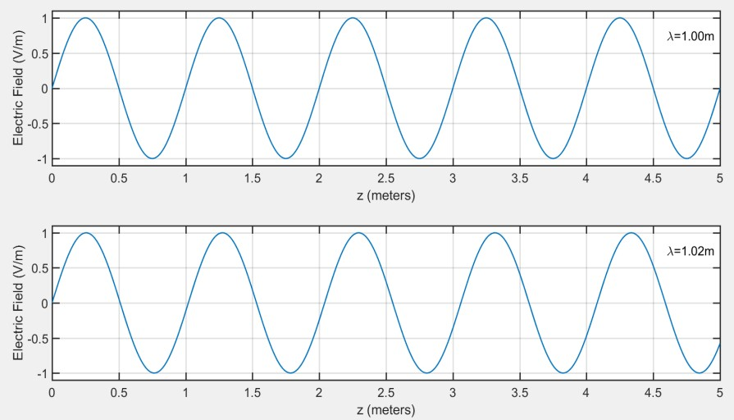
Material #1
Material #2
Fig. 4 The Parallel Wave Experiment
Modern oscilloscopes can easily detect a phase difference of one percent or even less, so if the length of the propagation region is large enough, we could likely to determine the relative dielectric constant of the unknown material to four or more significant figures. This is a very powerful measurement tool.
But how do we convert the phase difference into a calculation of the unknown dielectric constant? We will begin with a calculation of the phase difference between the two materials:
Substituting above for k1 and k2, we find:
Now, if we take the ratio of the phase difference to the phase of the known material, we obtain a ratio (which is typically listed as a percentage):
Simplifying this equation, we find:
So, if we know the percentage difference between the phase of the two signals, and if we know εr
for one of the materials, we can determine εr for the other material.

Slide 8
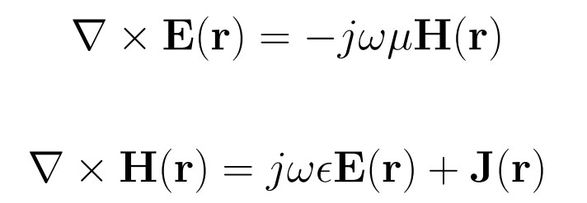
Example 20.4: The parallel wave experiment is run with one material containing a vacuum and the other material being unknown. The length of both tubes is one meter. The phase of the unknown material is 3° different from the signal in the vacuum. The frequency of both signals is 10GHz. What is the relative dielectric constant of the unknown material?
Plane Waves in a Lossy Dielectric
So far, we have only considered the propagation of plane waves in either free space or a perfect dielectric. (Remember that “dielectric” is essentially a synonym for “insulator,” so we have been studying plane wave propagation through perfect insulators. But there is no such thing as a perfect insulator, so what effect does the conductivity of the material have?
The short answer is that conductivity means that there are free electrons, and free electrons will always react to electromagnetic waves. According to Lenz’s Law, these reactions will always be such that they diminish or cancel the electromagnetic waves. So even before we do the math, we know that conductivity will cause electromagnetic waves to sinusoidally decay. We already discussed earlier, where we saw the magnetic wave applied to the surface of a conductor has a “skin depth,” which is a measure of how far the wave will penetrate into the conducting material before it substantially decays.
We have studied the wave propagation in an insulator and in a conductor. But we have the ability to study the full spectrum, from perfect insulator to good insulator to semiconductor to good conductor to perfect conductor. Let’s derive a model from Maxwell’s equations that can handle this full spectrum.
We will begin with phasor forms of Faraday’s Law, Ampere’s Law, and Ohm’s Law:
(1)
(2)

Slide 9
(3)
If we solve Equation (1) for H(r), substitute it into above equation, apply a mathematical identity to the left side, choose the Coulomb gauge and simplify the right side, we find:
(Yes, I skipped six steps in deriving this equation, but it’s very similar to two other derivations we have already seen. Let’s get to the good stuff.)
We will now assume that the wave is only polarized in one direction (y), so the equation simplifies to:
Now we will define a new constant γ and substitute it into Equation 20.17:
(4)
(5)
(6)
(7)
The constant γ is referred to as the “Propagation Constant,” and it has a real part and an imaginary part:
As we saw for conductors, the general form of the solution to Equation
Therefore, we can see that α controls how quickly the wave decays, and β controls how quickly it oscillates in space as it is decaying. For this reason, we call α the attenuation constant, and β is called the phase constant.
It is actually quite difficult to solve for α and β in this most general case. To do so, we must take the square root of Equation (6), which has both a real and an imaginary component, and then
(8)
(9)

Slide 10
we must separate the real and imaginary component of the square root. This derivation takes several pages, and it results in the following two equations:
(10)
Example 20.1: Determine the
(11)
Obviously, these equations are pretty nasty to use in practice, but they are essential when we are working a material that is neither predominantly an insulator nor predominantly a conductor.
We can also go one step further and calculate the phase velocity of a wave in this material. Since
β is filling the role of k in Equation (9), we can use b to determine phase velocity just as we used k in Equation (7):
(12)
The most interesting thing about this result is that different wave frequencies will travel at different velocities. This means that if the original wave had a variety of different frequency components, such as a square wave, then it will become distorted as it travels down the line. In particular, the corners will be rounded off, and if the signal is distorted enough, it can cause the signal transmission to fail. Since this effect is cumulative, it effectively places a limit on the length of a transmission over a lossy medium and leads to the need for occasional repeaters.
10

Slide 11
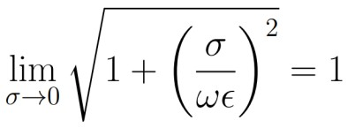
If we perform a similar analysis of the magnetic field in a lossy dielectric medium, we can then use that result to calculate the characteristic impedance of the medium. In this case, the impedance will be complex:
Example 20.5: A 20 V/m plane wave whose frequency is 900 MHz propagates in the positive z direction. The electric field is polarized in the positive x direction. The dielectric material has a relative permittivity of 10, is non-ferromagnetic, and has a conductivity of 10 S/m. What is the full expression for the electric field as it decays inside the dielectric? What are the phase velocity and characteristic impedance of the wave in this material?
(13)
Plane Wave Propagation in Insulators and Conductors
Of course, if Equations (9) to (15) are applicable in all materials, we should be able to consider the two extreme cases and confirm that these equations reduce down to the quantities we have already seen for those cases. We will first consider a very good insulator, where σ →0. Each of the equations we must study includes the same square root term, which reduces to one in this limit:
Applying this limit to the equations for α, β, vφ, and Zc, we obtain:
(1)
(2)

Slide 12
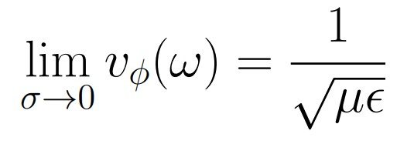
(3)
(4)
(5)
(6)
So, we see that the general forms of these equations, in the limit of zero conductance, reduce back to exactly the same equations we originally derived for free space. In particular, there will be no dissipation (α=0), and β reduces down to the wave number k.
In the limit of high conductivity, we will need to take the opposite limit. We will first consider the square root term:
Once again applying this limit to the equations for α, β, vφ, and Zc, we obtain:
(7)
(8)
(9)
(10)

Slide 13
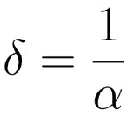
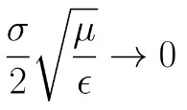
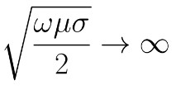
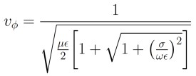
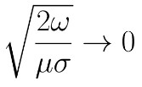
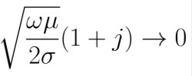
(11)
These equations are exactly the same as those derived in a completely different manner. We also defined the skin depth δ to be the inverse of the attenuation constant. It provides a measure of how far a wave will extend into a conductive material before it significantly decays.
The following table summarizes all of these results for the general case and the two limits:
Table 1 Summary of Wave Propagation in Non-Vacuum Conditions
(12)
(13)
 | Insulator (σ→0) | General Case | Conductor (σ→∞)
α
β
v_{φ}
Z_{c}

Slide 14
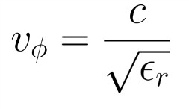
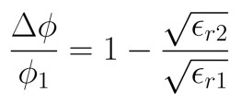
Summary
To understand traveling waves, we can either stay at one point and watch as the wave moves past, or we can take a snapshot of all of space at one instant in time.
When an electromagnetic wave propagates through a dielectric material, its wave number increases, radial frequency is unchanged, and its phase velocity decreases when compared to propagation through a vacuum.
The parallel wave experiment can be used to determine the dielectric constant of an unknown material with a high level of precision when compared to a known material such as free space:
Time-harmonic electromagnetic waves will decay when they pass through a material with non-zero conductivity. The general form of the equation for such sinusoidal decay is:
Where α is known as the attenuation constant and β is known as the phase constant. These constants, along with phase velocity and characteristic impedance, can be calculated for a general case, and these general equations reduce to the known quantities in the limits of low conductivity (insulators) and high conductivity (conductors). The results are summarized in Table 1.

